Slide 1
REACT and REDUX

Slide 2
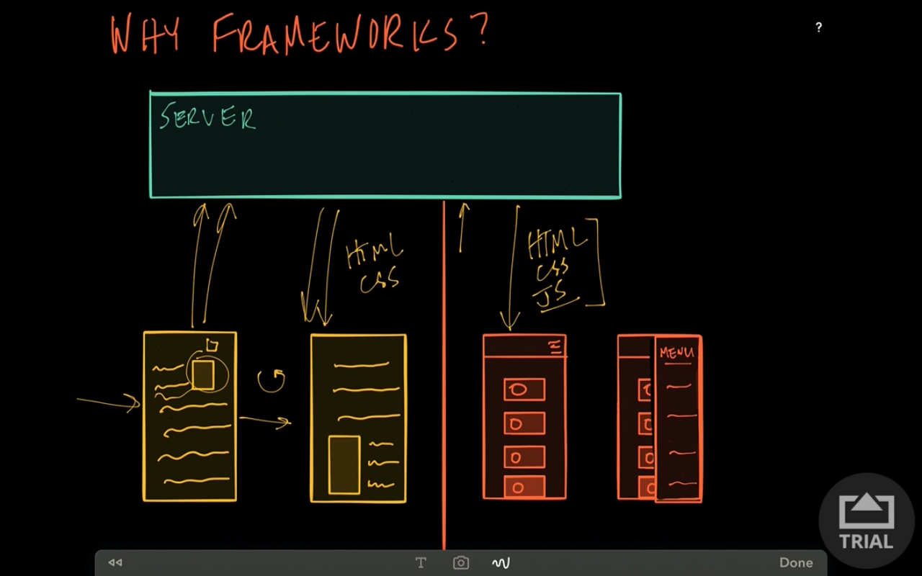
Why Framework

Slide 3
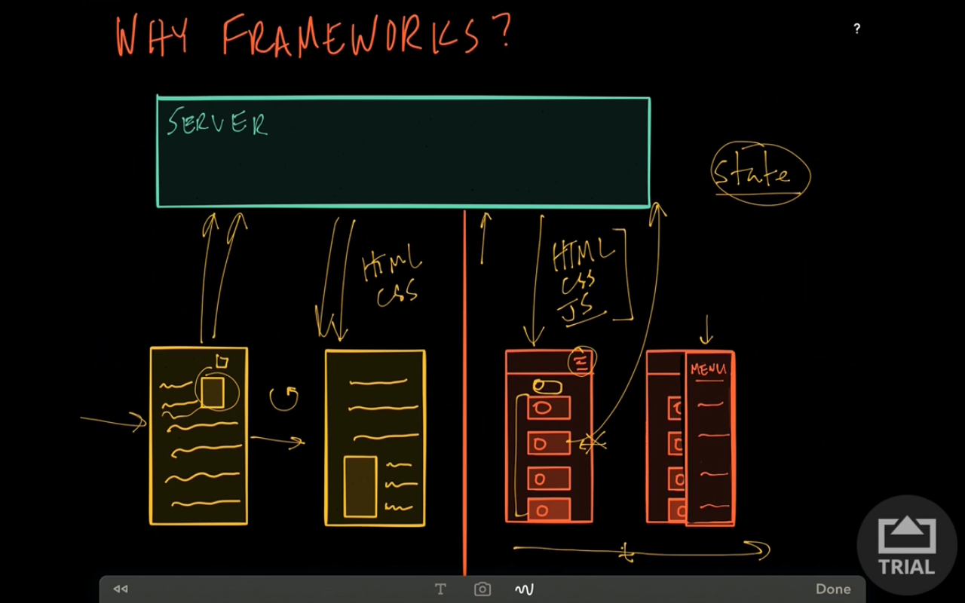
SPA

Slide 4
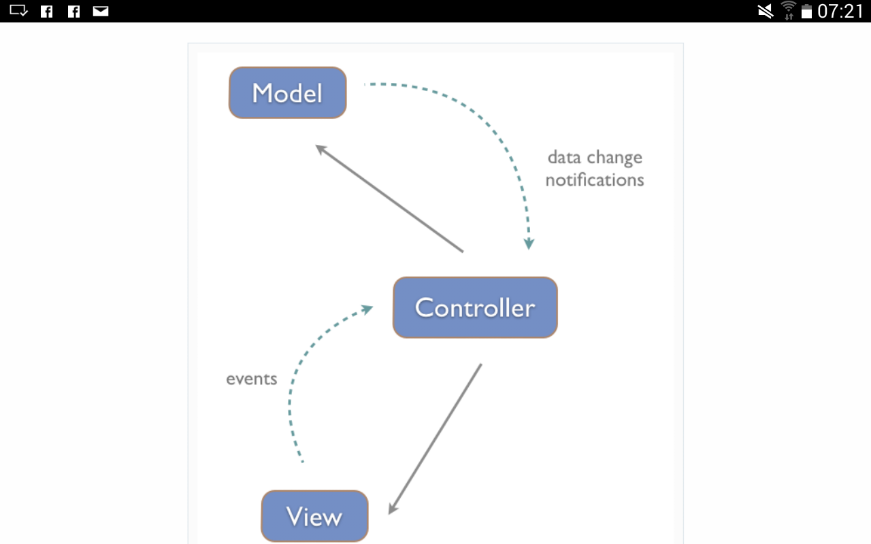
MVC

Slide 5
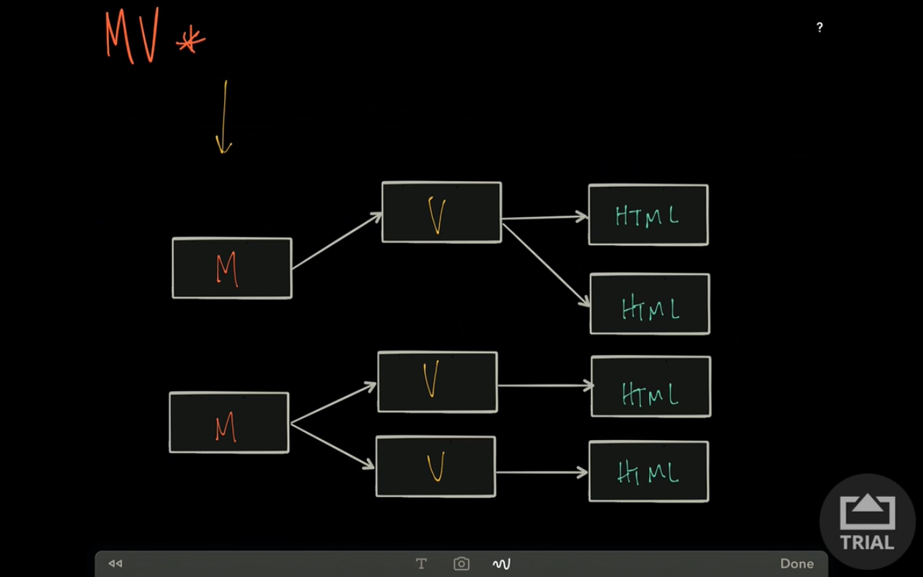
MVC

Slide 6
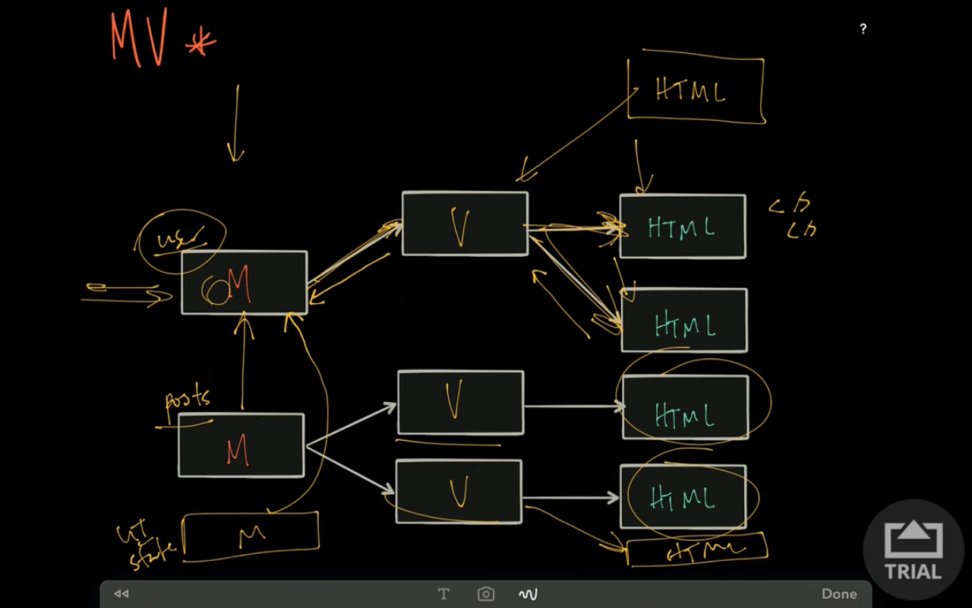
MVC
As the application grows, we add more models and views,then which view is updating model we will not know and debugging will become horrible

Slide 7
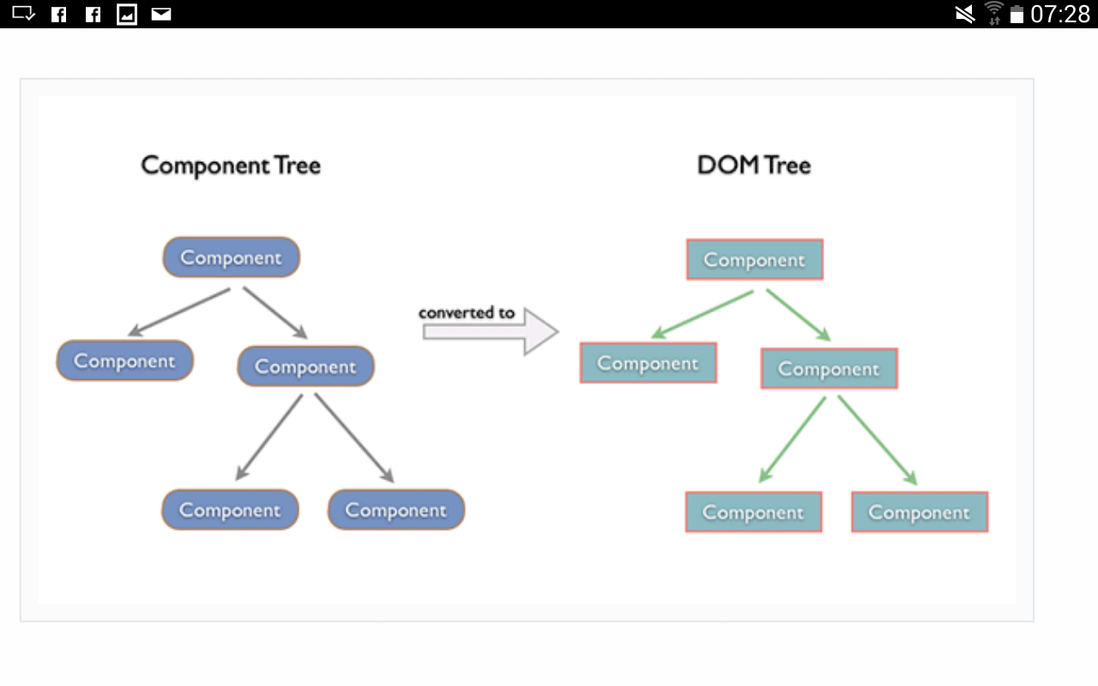
REACT

Slide 8
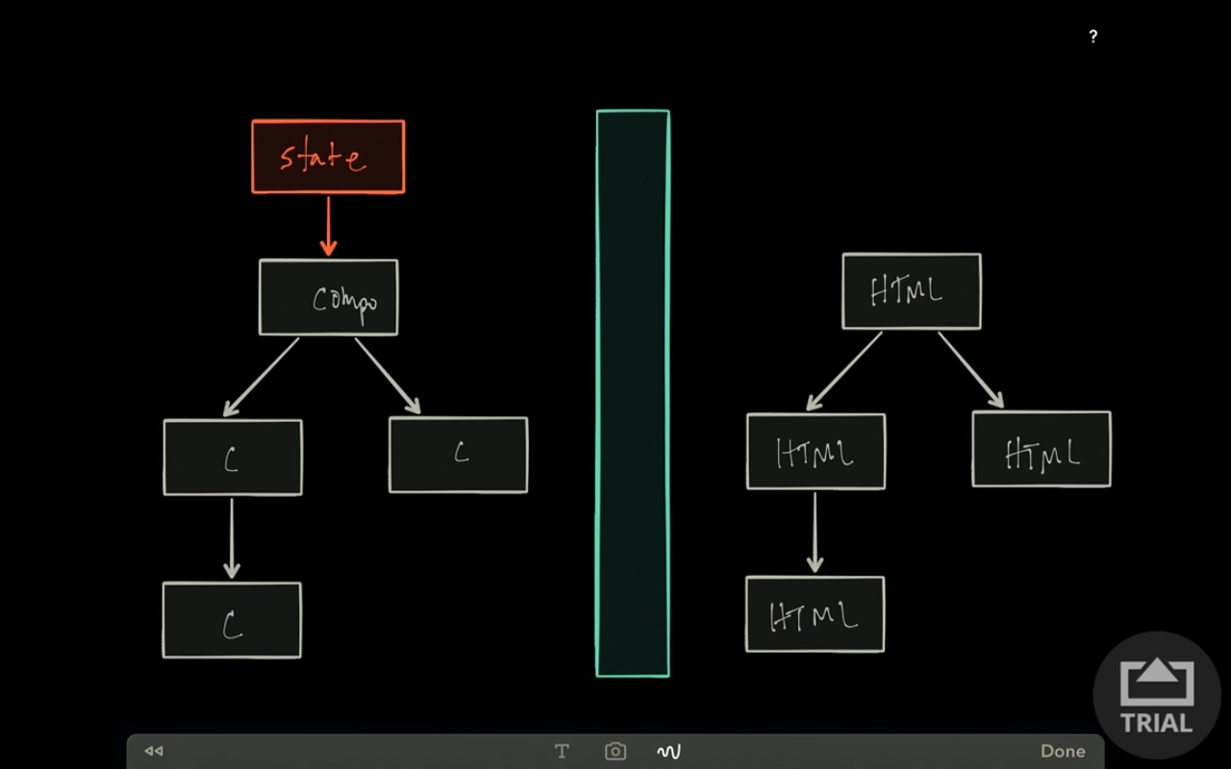
React

Slide 9
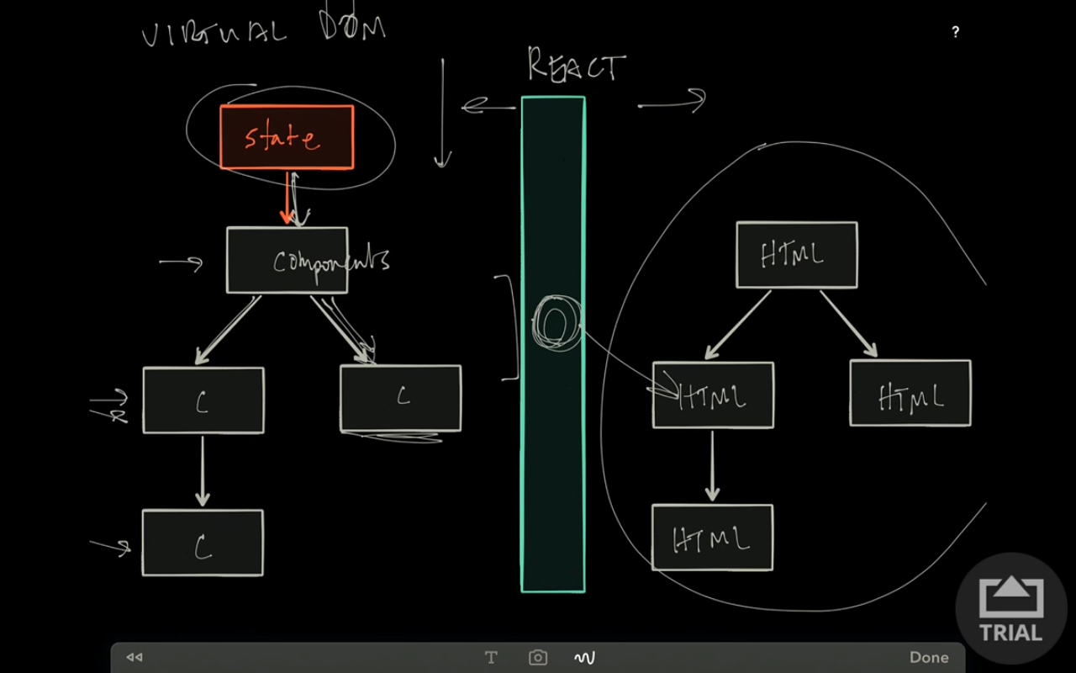
React

Slide 10
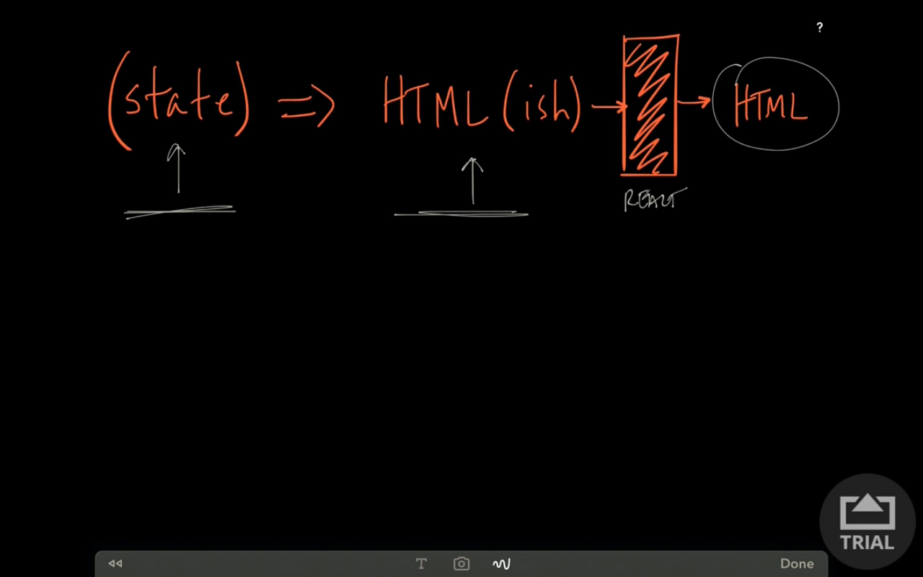
React

Slide 11
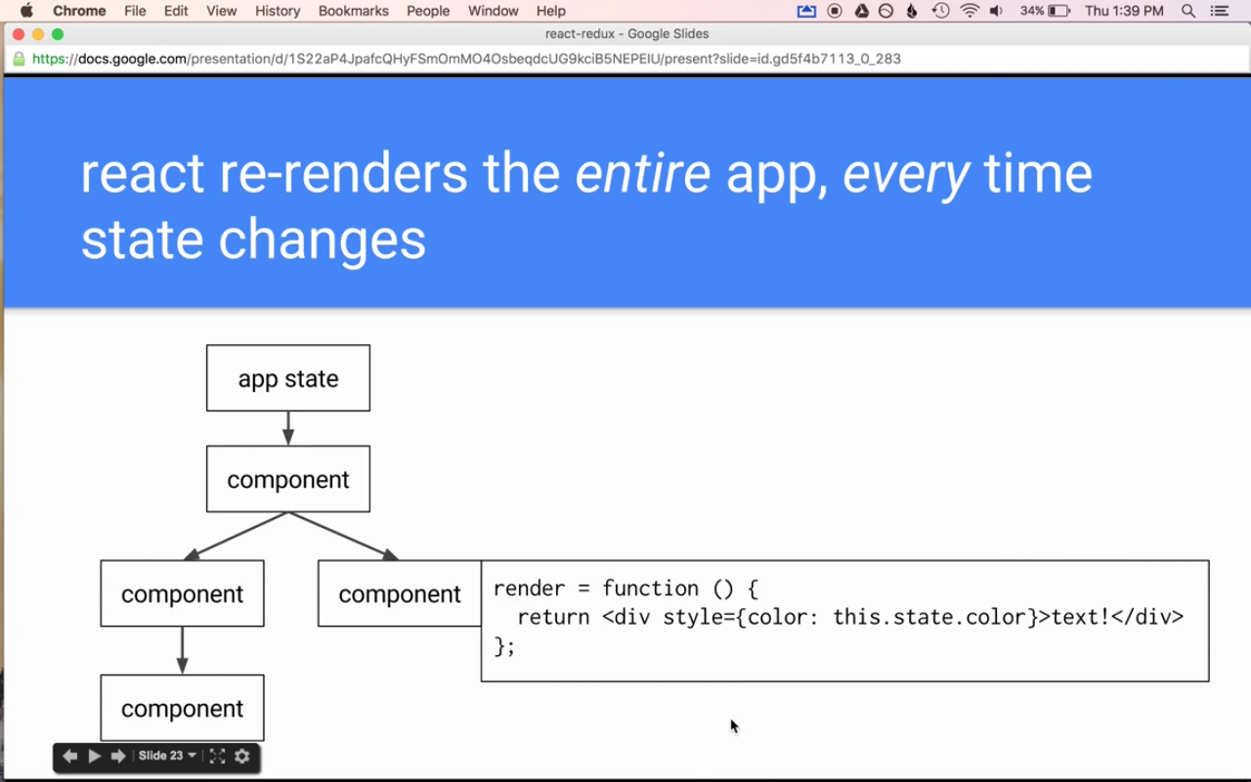
React

Slide 12
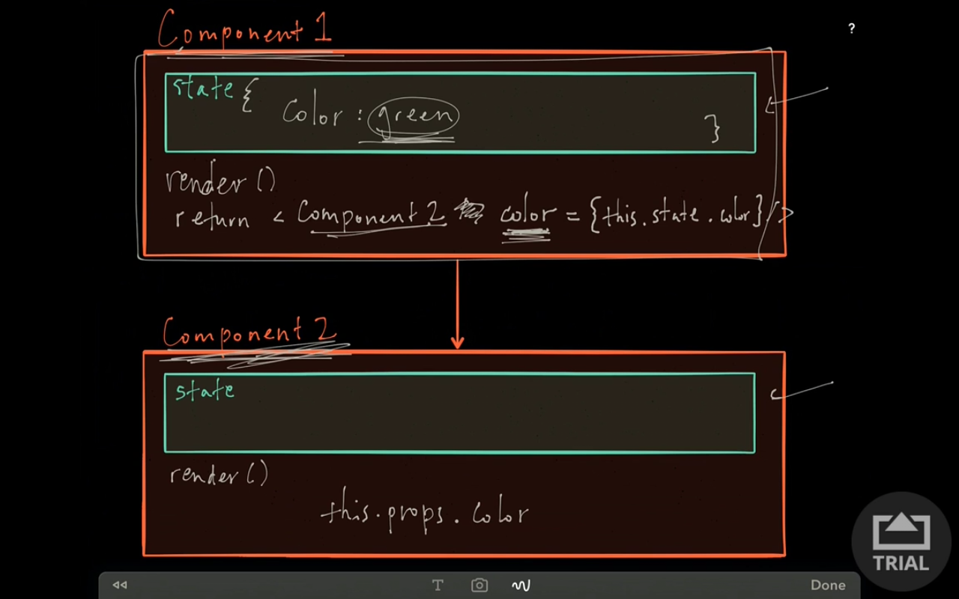
React – Component Tree

Slide 13
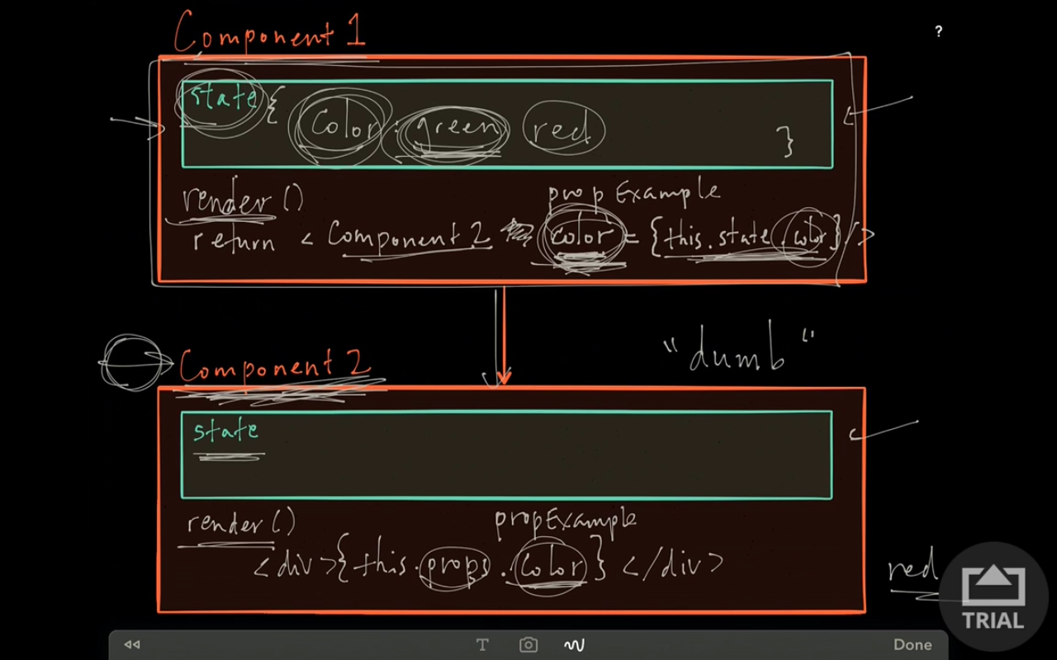
React – Component Tree

Slide 14
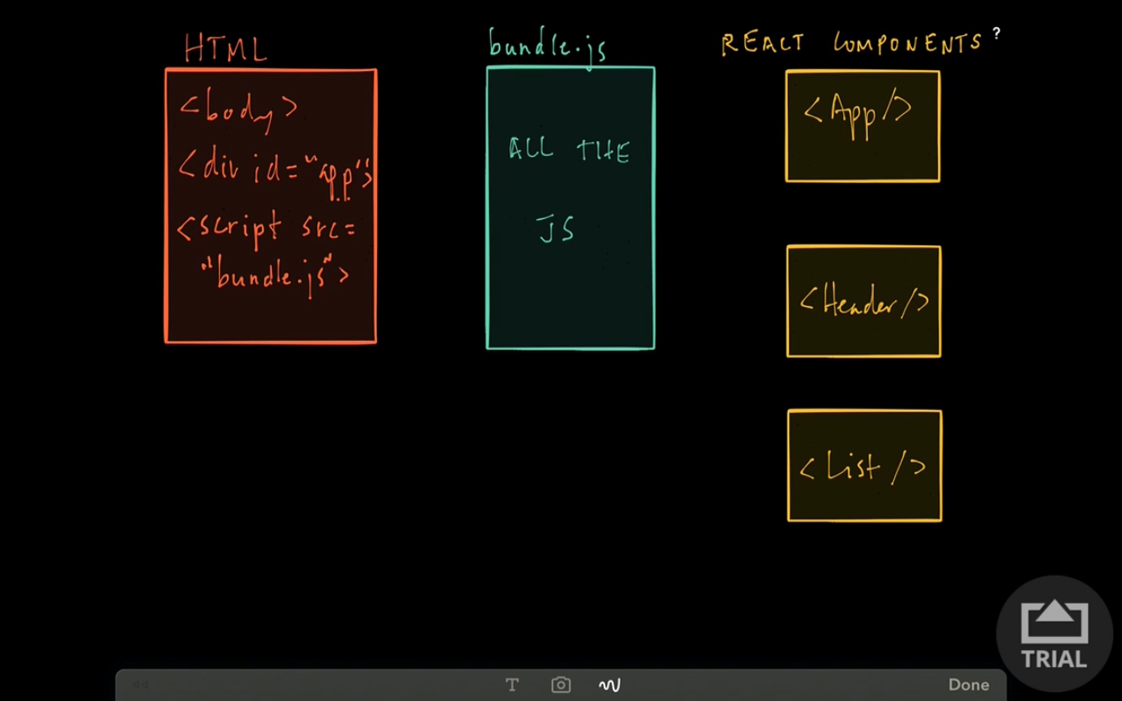
React – Bundling with webpack

Slide 15
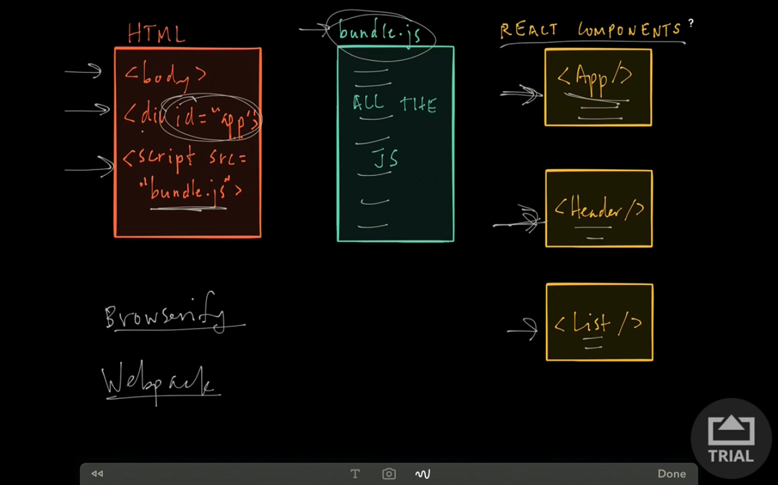
React – Bundling with webpack

Slide 16
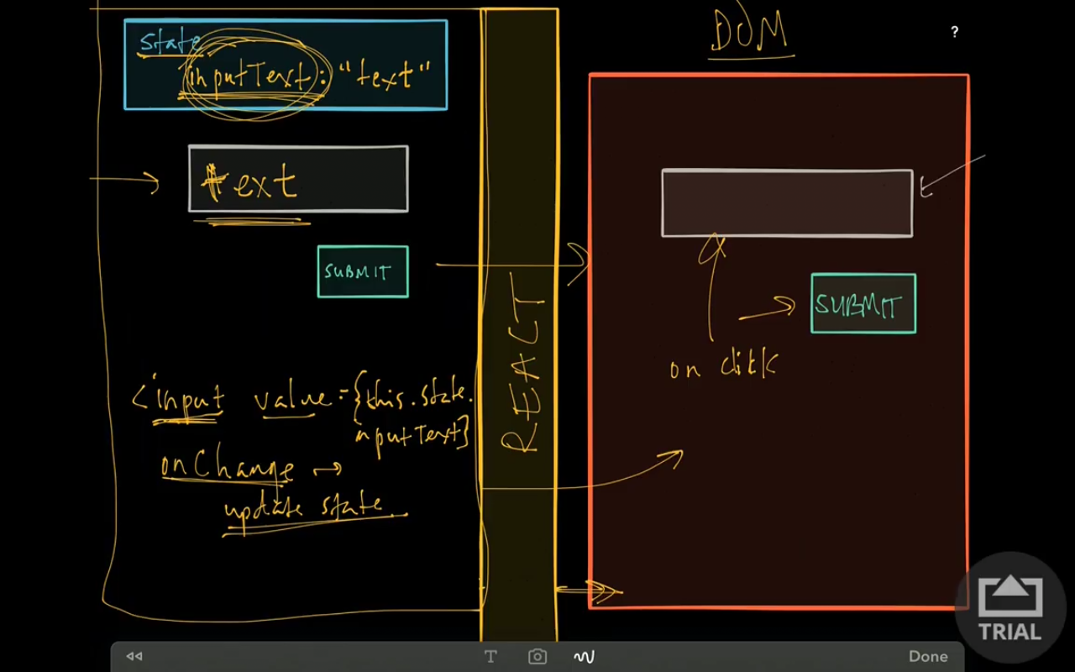
React – state and props

Slide 17
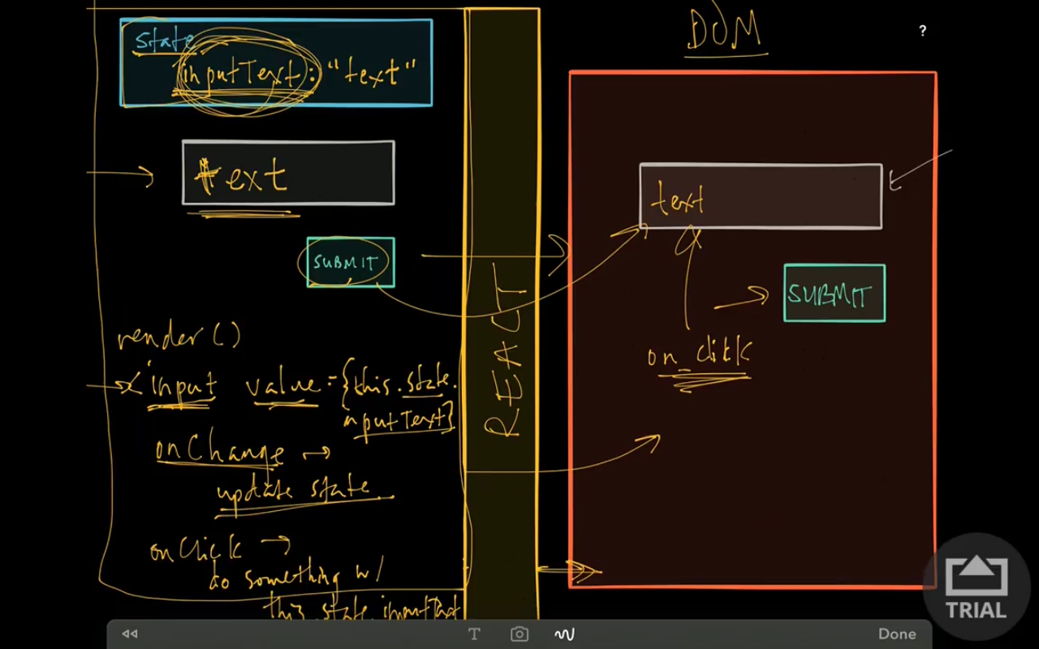
React – state and props

Slide 18
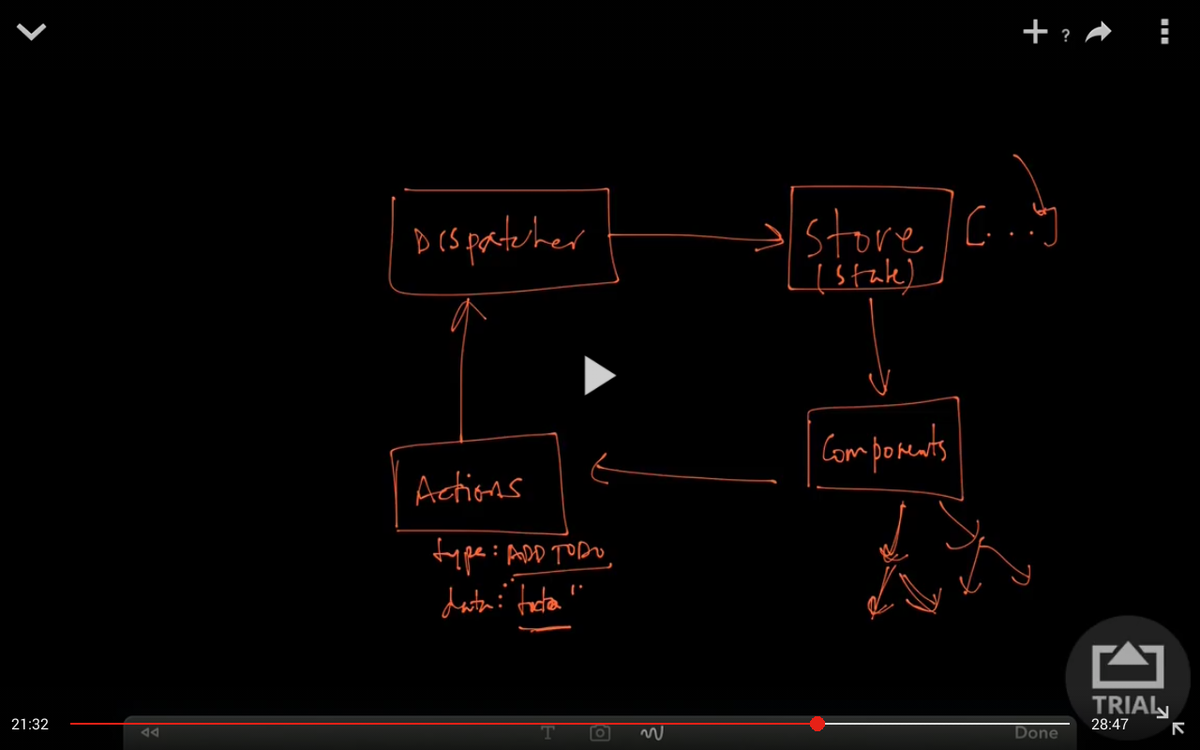
FLUX

Slide 19
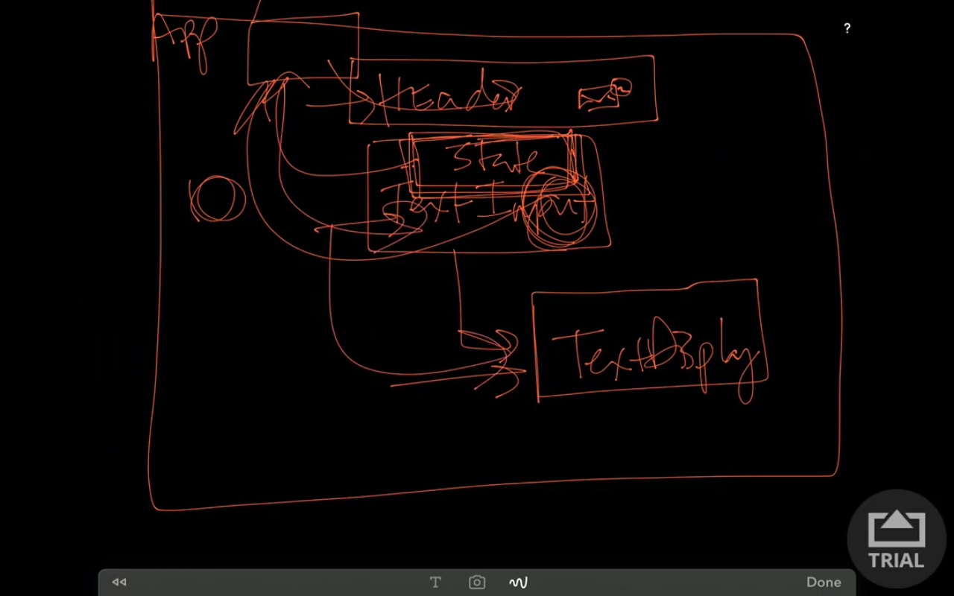
REACT
If Header wants to access state,
We have to push it to App but it
Is not a good practice.
Solution: Flux or Redux

Slide 20
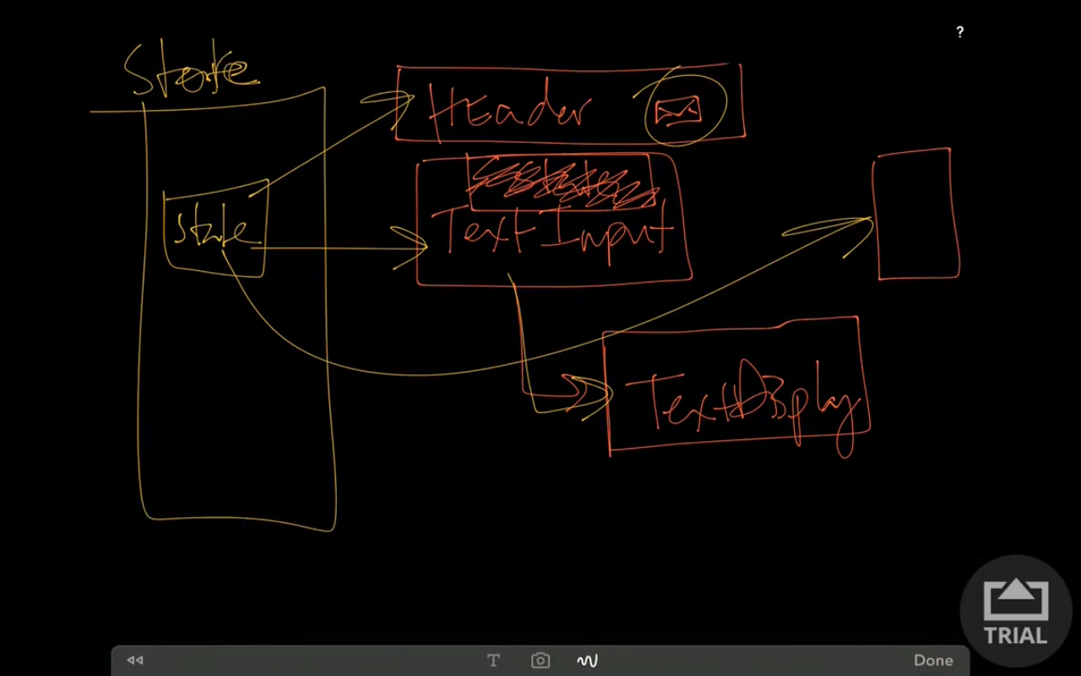
Redux

Slide 21

Redux

Slide 22
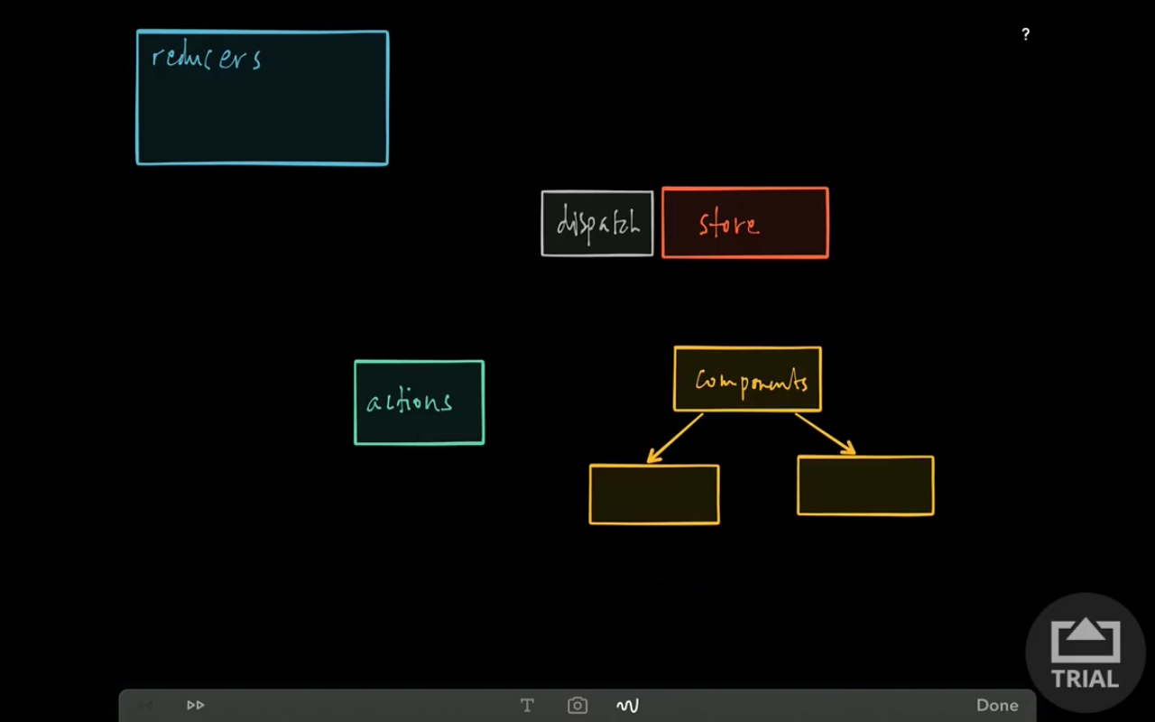
Redux

Slide 23
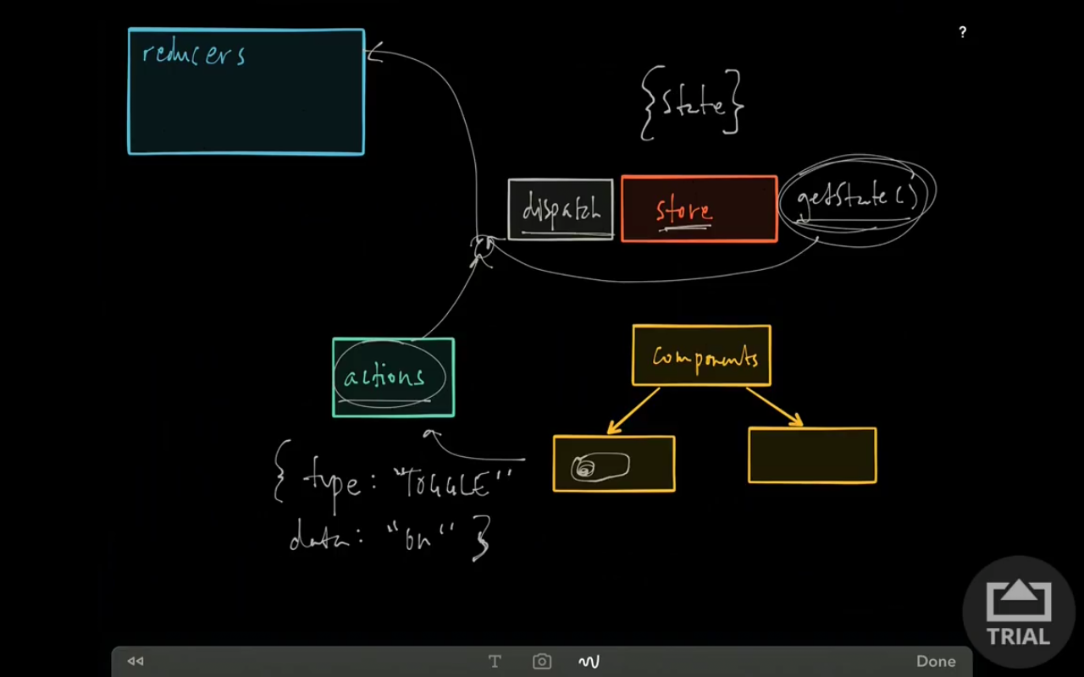
Redux

Slide 24
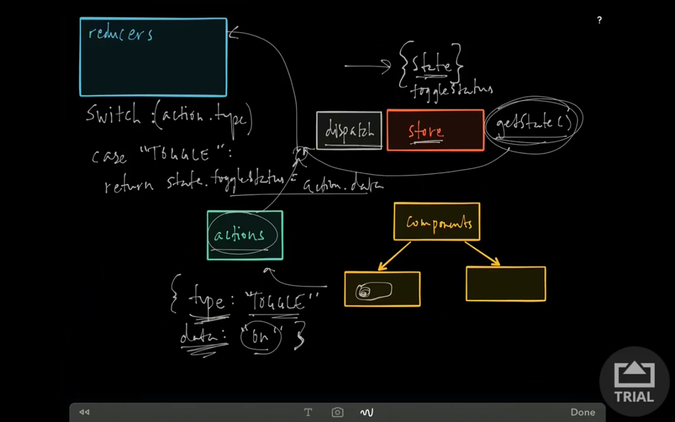
Redux

Slide 25
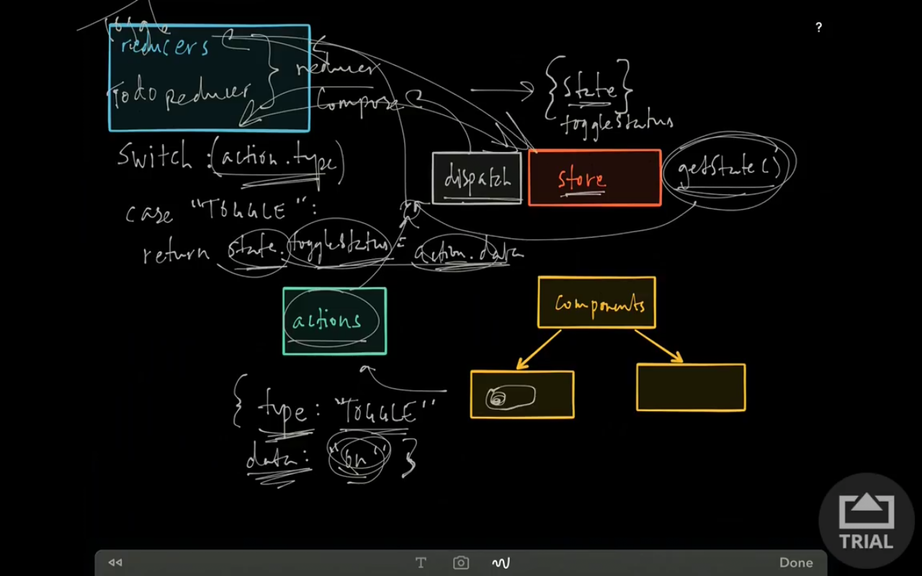
Redux

Slide 26
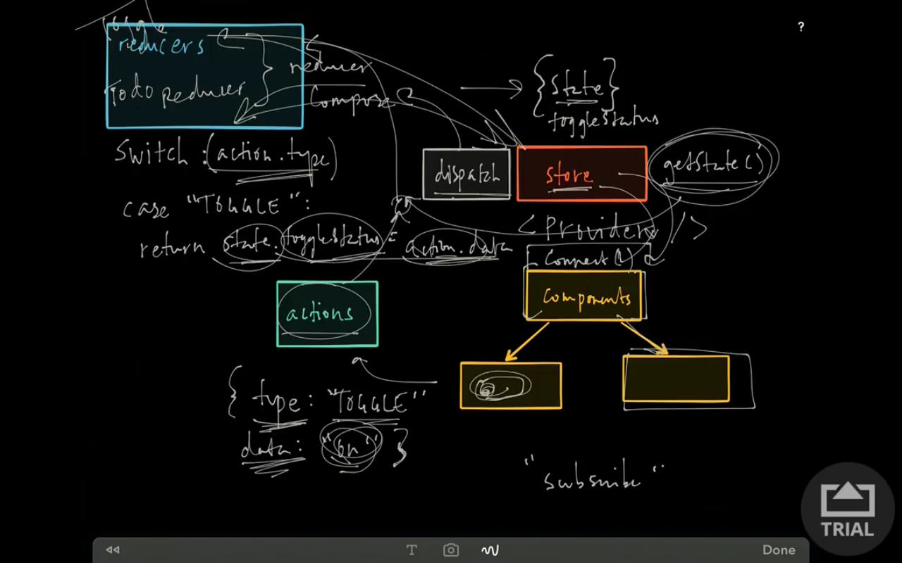
Redux

